Slide 1
Subject : COMP6360004 - ALGORITHM AND PROGRAMMING
Program Control: Selection

Slide 2
Learning Outcomes
At the end of this session, student will be able to:
LO2 : Apply syntax and functions in C language in problem solving
LO3 : Construct a program using C language in problem solving

Slide 3
Sub Topics
If-Else
Using ? :
Nested If
Switch-Case
Create simple program using selection and logical operators

Slide 4
Selection: if statement
Syntax :
if (boolean expression) statement; or if (boolean expression) { statement1; statement2; …… }
If boolean expression resulting in TRUE, then a statement or some statements will be executed.
Flow Chart of IF Statement
false
true
condition
statements
Block of statements

Slide 5
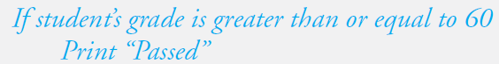
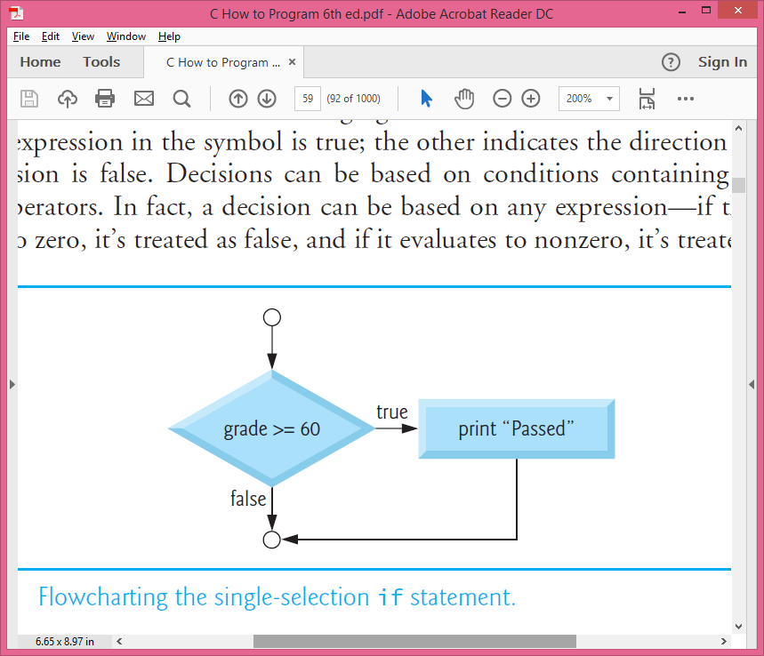
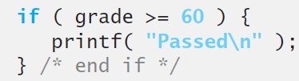
Selection: if statement
For example, suppose the passing grade on an exam is 60.
The pseudocode statement :
Syntax :

Slide 6
Selection: if..else statement
Syntax : if (boolean expression) statement1; else statement2; or if (boolean expression) { statement1; statement2; …… } else { statement3; statement4; …… }
If boolean expression resulting in TRUE, then statement1 or block statement1 will be executed,
if FALSE, then statement2 or block statement2 be executed.
Flow Chart of IF-ELSE Statement
false
true
condition
statement2
statement1

Slide 7
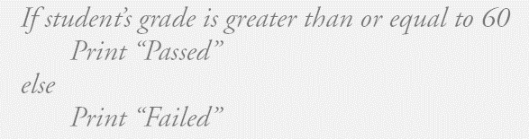
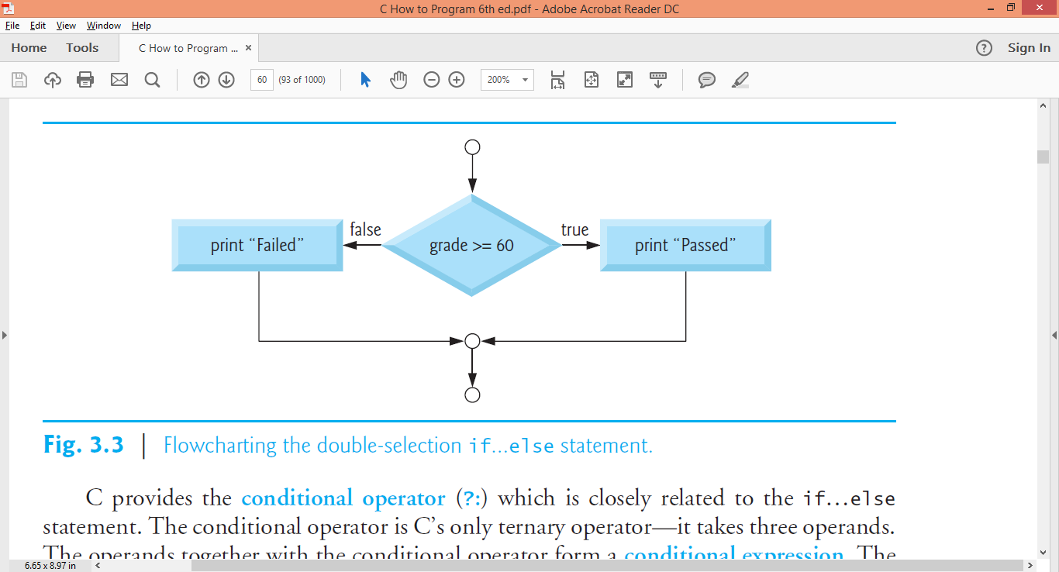
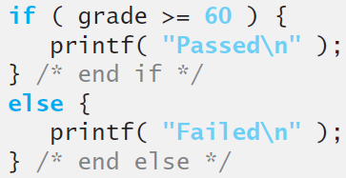
Selection: if..else statement
The pseudocode statement :
Syntax :
For example, prints Passed if the student’s grade is greater than or equal to 60 and prints Failed if the student’s grade is less than 60.

Slide 8
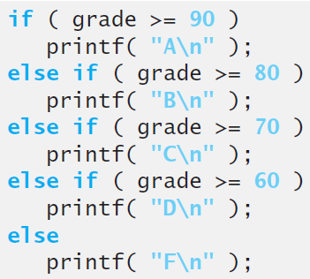
Selection: nested if
Syntax : if (boolean expression) statement1; if (boolean expression) statement2; if (boolean expression) statement3; or if (boolean expression) statement1; else if (boolean expression) statement2; else if (boolean expression) statement3;
Nested selection occurs when the word IF appears more than once within IF statement.
For example, print A for exam grades greater than or equal to 90, B for grades greater than or equal to 80, C for grades greater than or equal to 70, D for grades greater than or equal to 60, and F for all other grades.
Flow Chart of NESTED IF Statement
false
condition
true
statement1
false
condition
true
false
true
statement2
condition
statement3

Slide 9
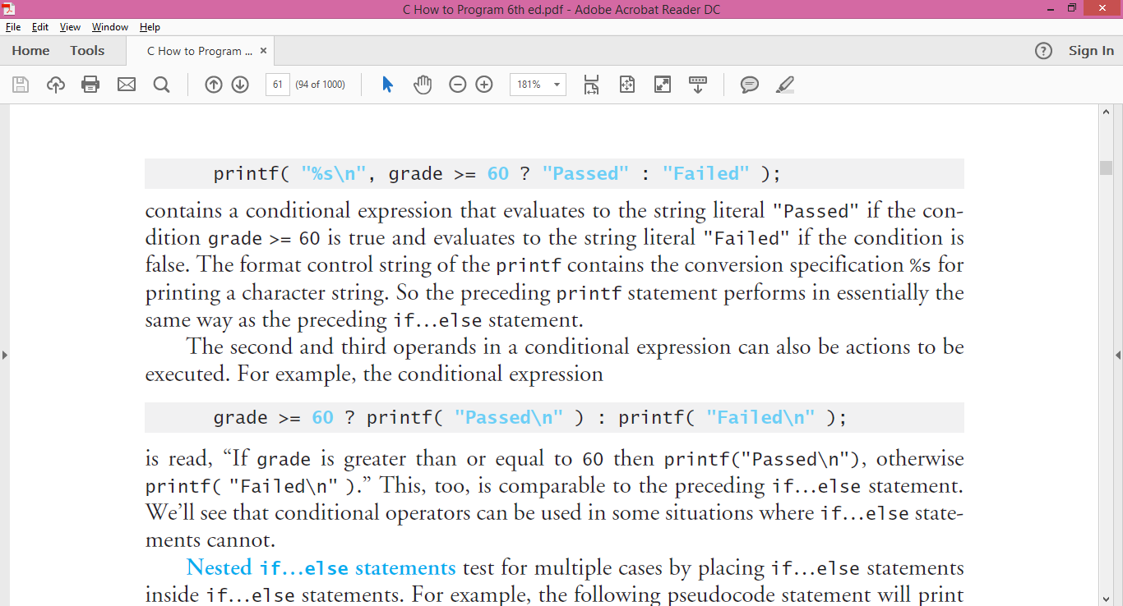
if…else statements using conditional operator (?:)
The pseudocode statement :
Syntax :
or
Syntax:
condition ? then-expression : else-expression
For example, prints Passed if the student’s grade is greater than or equal to 60 and prints Failed if the student’s grade is less than 60.
C provides the conditional operator (?:) which is closely related to the if…else statement. The conditional operator is C’s only ternary operator—it takes three operands. The operands together with the conditional operator form a conditional expression. The first operand is a condition. The second operand is the value for the entire conditional expression if the condition is true and the third operand is the value for the entire conditional expression if the condition is false.

Slide 10
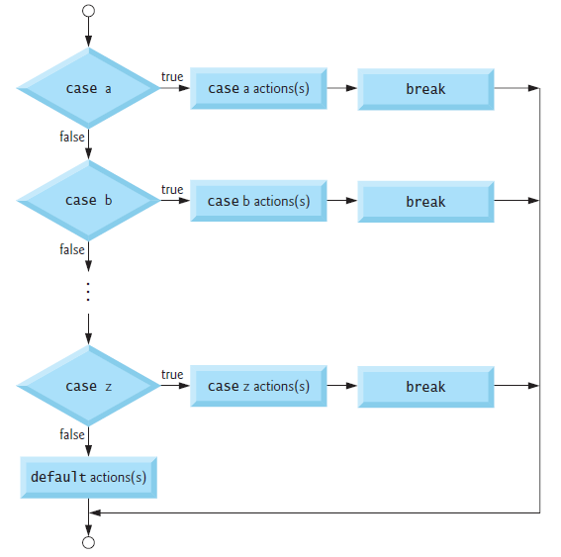
Selection: Switch Case
This statement (Switch-Case Operation) is used in exchange of IF-ELSE, when if-else nested number of level is enormous and difficult to read.
Flow Chart of Switch-Case Statement
Syntax : switch (expression) { case constant1 : statements1; break; . . case constant2 : statements2; break; default : statements; }
Switch statement evaluate an expression by looking up for each case constant value. If an expression value matches with a case constant value then related statement/s is executed. If nothing match then default statement is executed. Expression and constant type should be integer (including char)

Slide 11
Selection: Switch Case
#include <stdio.h>
int main()
{
float value1, value2; char op;
while(1) {
printf(“\n Type value1 operator value2 \n”);
scanf(“%f %c %f”, &value1, &op, &value2);
switch(op){
case(‘+’) : printf(“ = %f”, value1 + value2); break;
case(‘-’) : printf(“ = %f”, value1 - value2); break;
case(‘*’) : printf(“ = %f”, value1 * value2); break;
case(‘/’) : printf(“ = %f”, value1 / value2); break;
default : printf(“ unknown operator!”);
}
}
return(0);
}
Note: case(’+’) can also be written as case ’+’

Slide 12
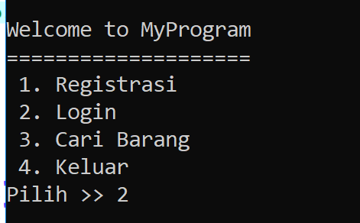

Create simple program
using selection and logical operators
Create a Menu in C Program using switch case

Slide 13
Create simple program
using selection and logical operators
Create a C program to find the largest number among three numbers, using:
if
if...else
nested if

Slide 14
Reference
Paul Deitel & Harvey Deitel. (2016). C how to program: with an introduction to C++. 08. Pearson Education. Hoboken. ISBN: 9780133976892.
Choosing between Alternatives: http://docs.roxen.com/pike/7.0/tutorial/statements/conditions.xml
Getting Controls: http://aelinik.free.fr/c/ch10.htm

Slide 15
THANK YOU

